Slide 1


研究方向
廖峴鋒

Slide 2
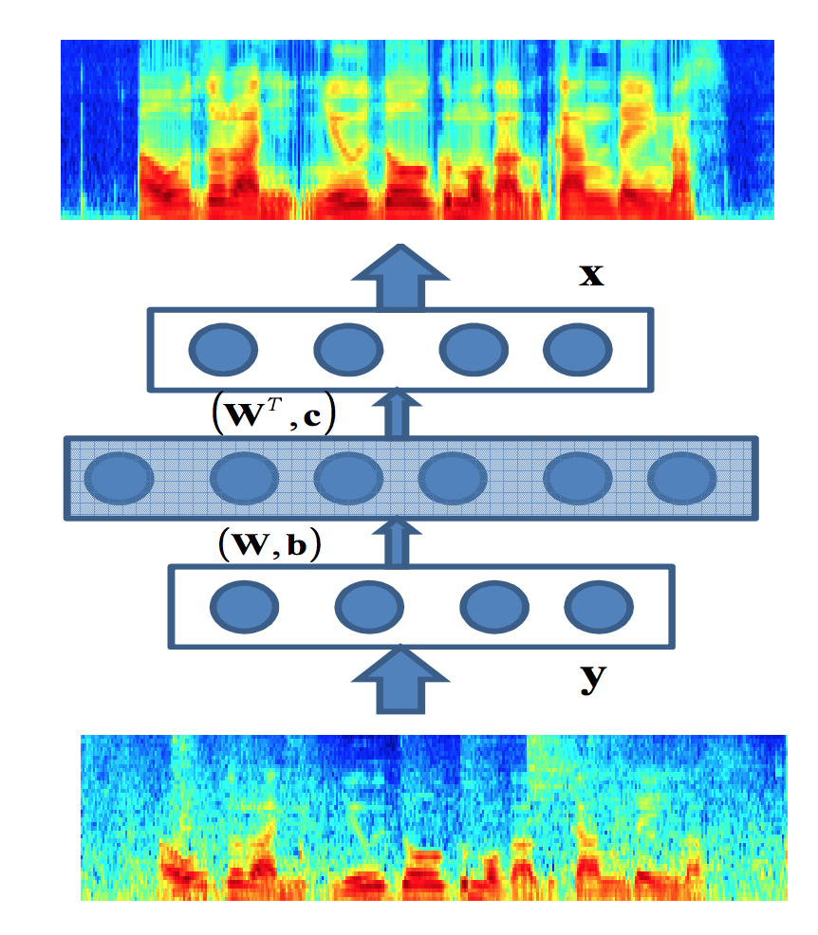
Speech enhancement
Enhanced speech
Problems
Training/testing noise environment mismatch (Interspeech 2019)
High-level information (Interspeech 2019)
Noisy speech
[1] Lu, Xugang, et al. "Speech enhancement based on
deep denoising autoencoder." Interspeech. 2013.

Slide 3
Speech enhancement
Training/testing noise environment mismatch (Interspeech 2019)
Liao, C.-F., Tsao, Y., Lee, H.-Y., and Wang, H.-M. Noise adaptive speech enhancement using domain adversarial training.

Slide 4
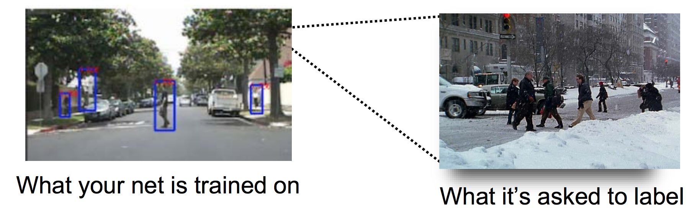
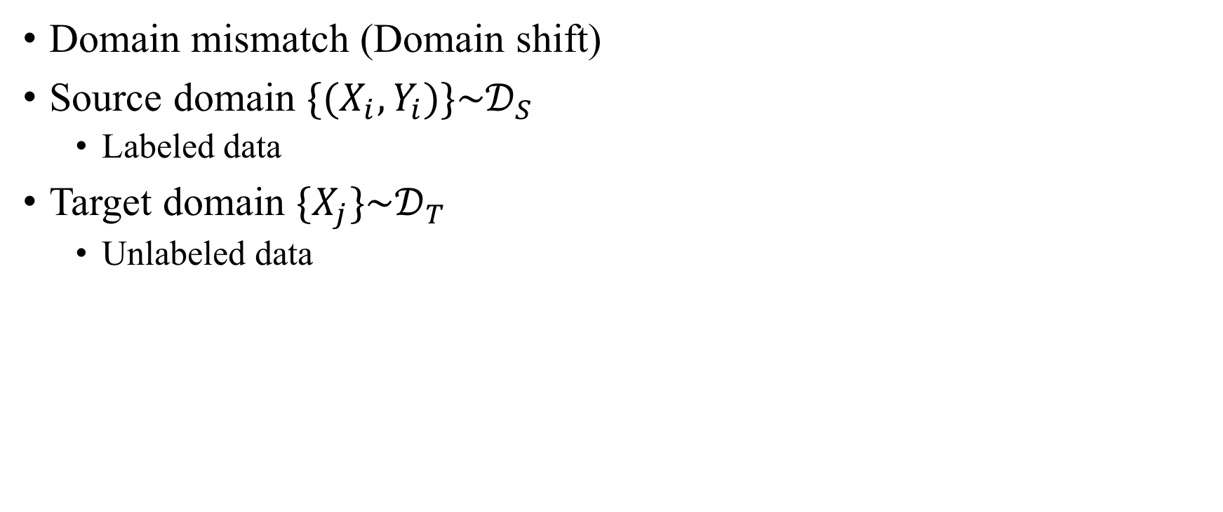
Unsupervised domain adaptation
Domain mismatch (Domain shift)
Source domain ${\{{(X}_{i},Y_{i})\}\sim 𝒟}_{S}$
Labeled data
Target domain ${\{X_{j}\}\sim 𝒟}_{T}$
Unlabeled data
http://www.eecs.umich.edu/eecs/pdfs/events/4142.pdf
Notes:
Training的街景跟實際testing的街景不一樣，不同季節

Slide 5
Noise adaptive SE
Notes:
model的應用情節：adapt到某個噪音環境

Slide 6
Dataset
TIMIT dataset
Source domain = 15,000 noisy (5 noise types)
Target domain = 220 noisy (1 noise type)
Test set = 192 noisy
Notes:
因為是針對target noise做adaptation，所以testing noise是一樣的

Slide 7
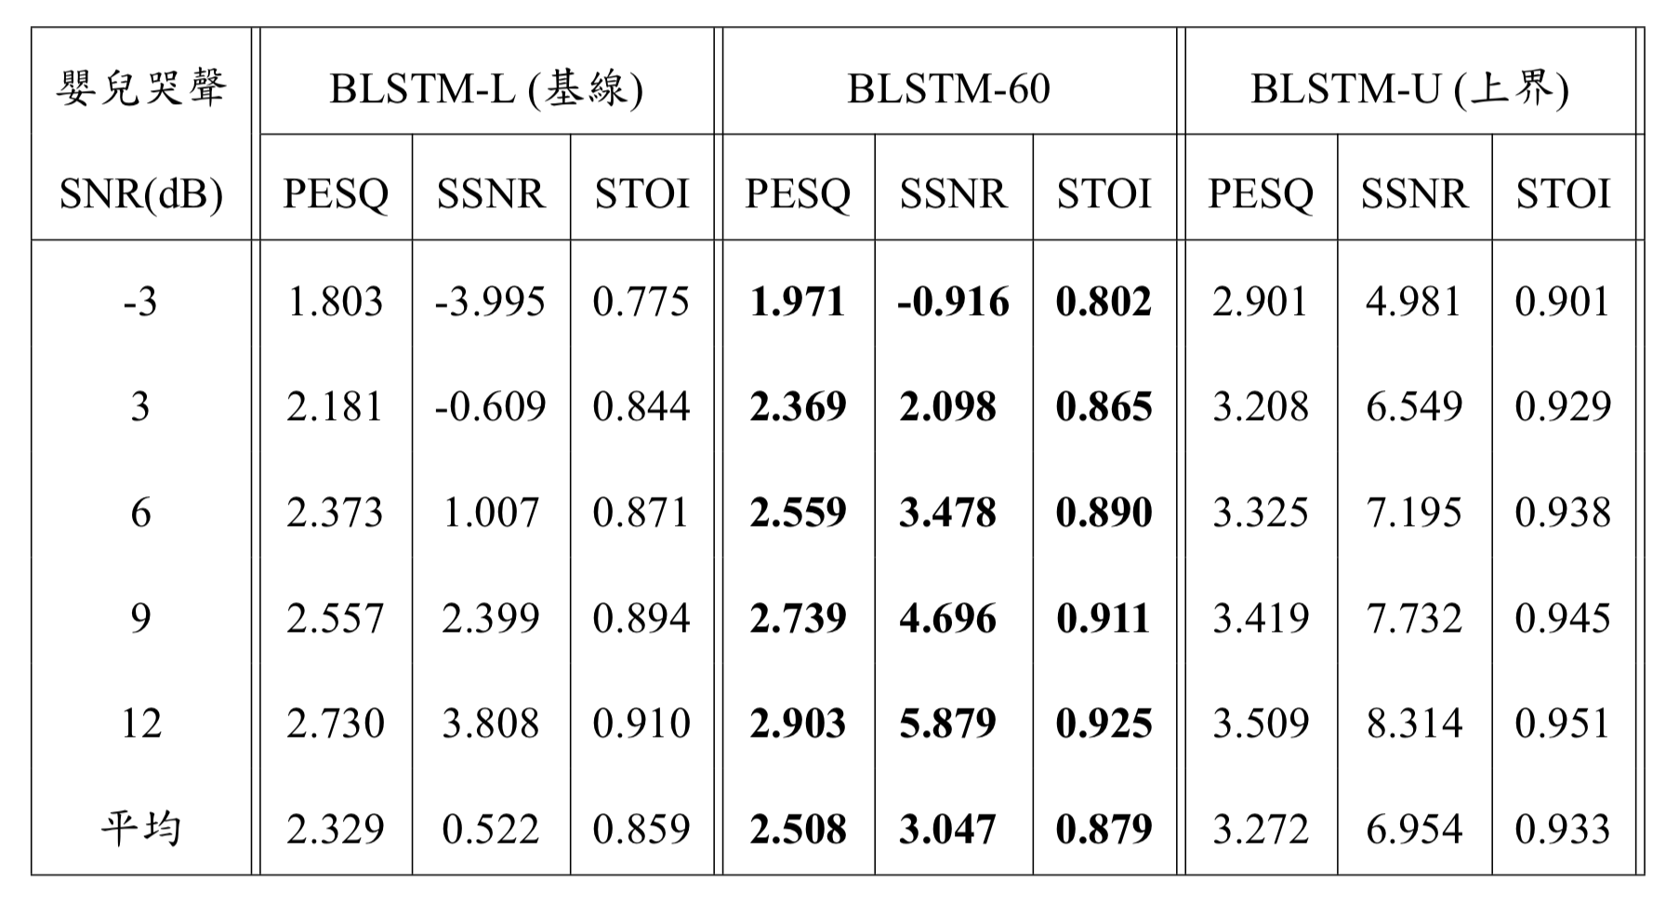
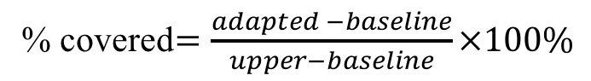
Results – adapted to baby cry
% covered$=\frac{adapted −baseline}{upper−baseline}×100\%$
covered
19%
39%
27%
Notes:
只要60句adaptation data就有顯著進步

Slide 8
Results – adapted to baby cry
Different amount of target domain data for adaptation
Notes:
PESQ跟SSNR有隨著adaptation data變多跟著增加的趨勢

Slide 9
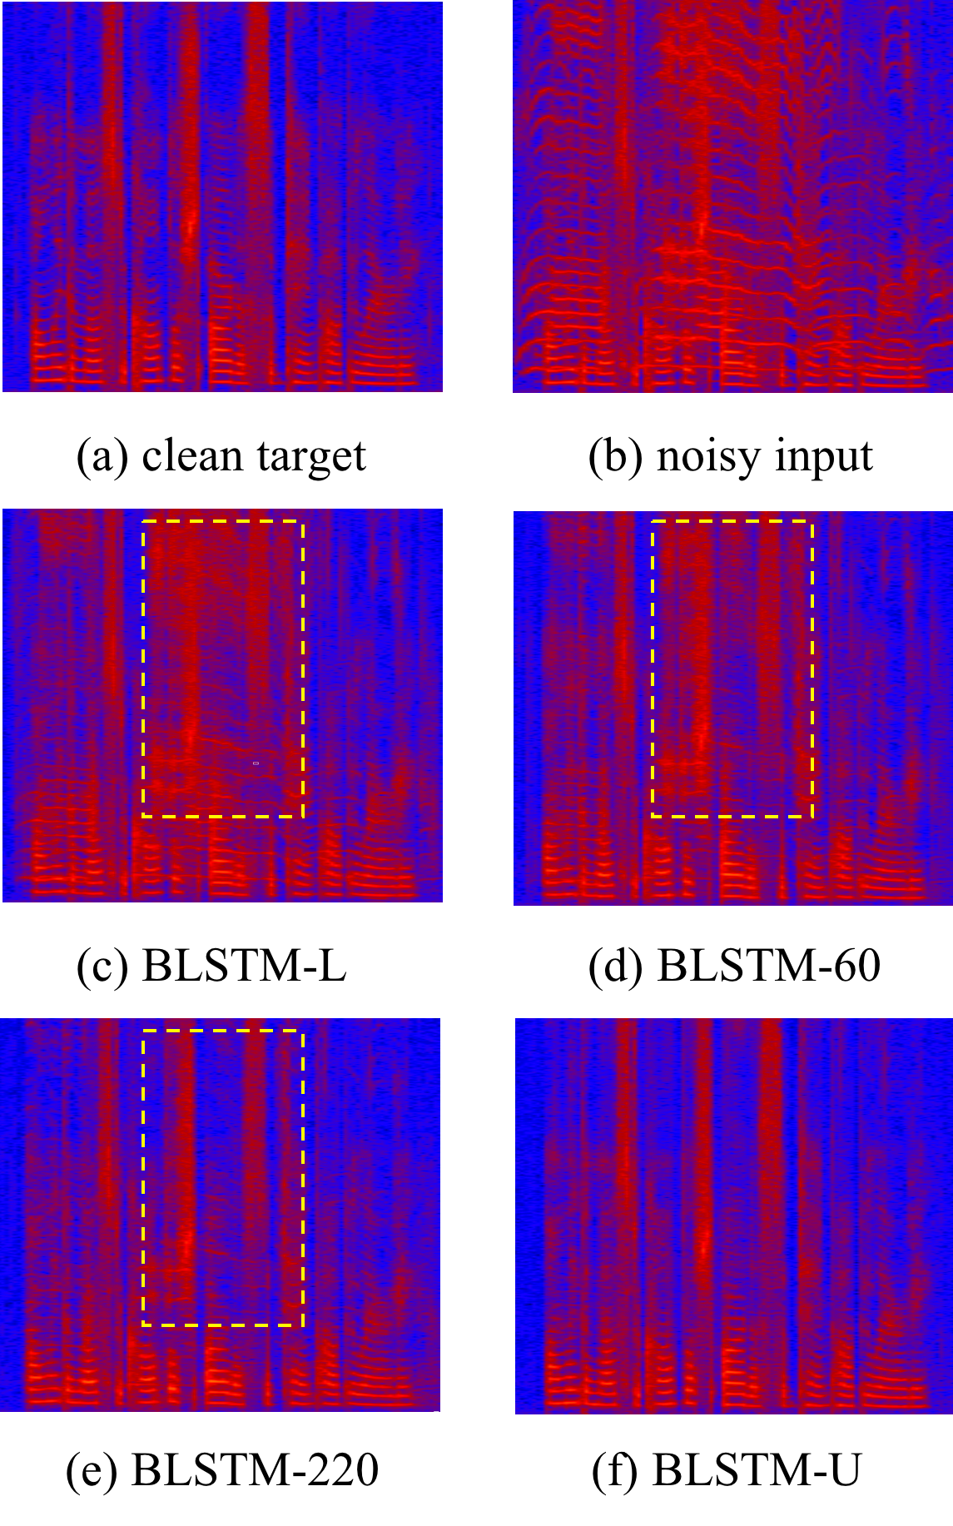
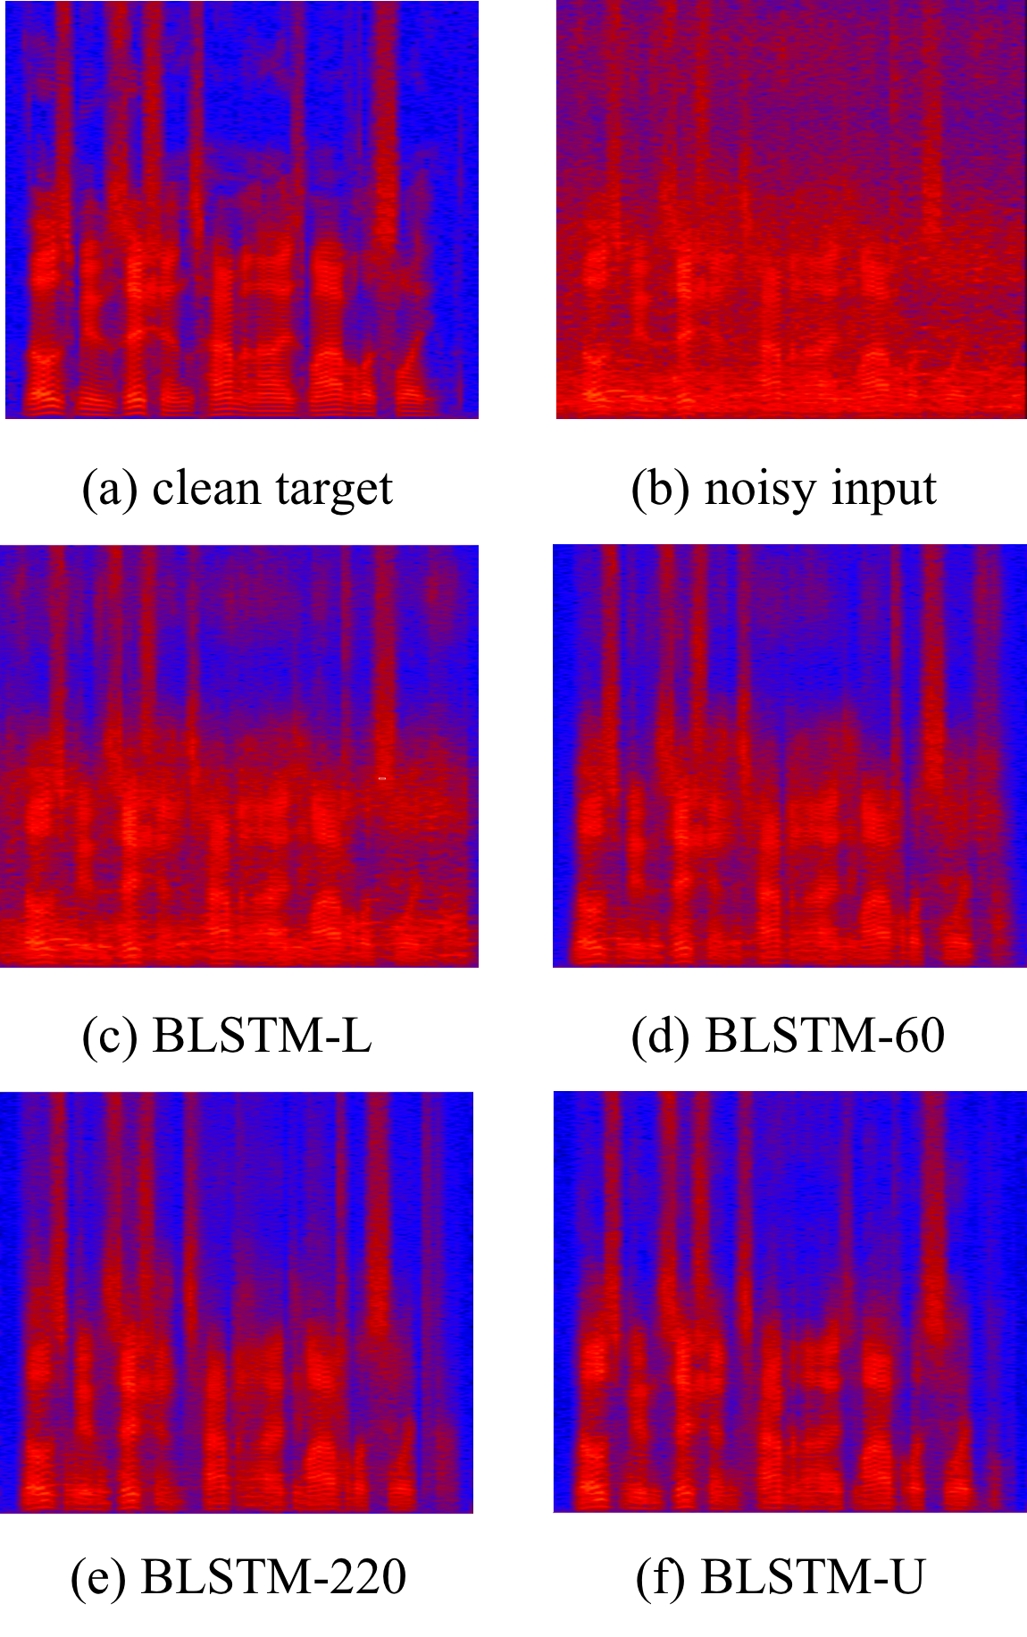


Slide 10
Output space noise adaptive SE
Inspired by Tsai, et al. [3] (semantic segmentation)
Notes:
Discriminator input變成enhancement model的output

Slide 11
Dataset
TIMIT dataset
Source domain = 100 clean * 5 noise types => 3,000 noisy
Target domain = 1000 clean * 5 noise type => 30,000 noisy
Test set = 192 clean * 2 noise type ([baby cry, airplane engine])

Slide 12
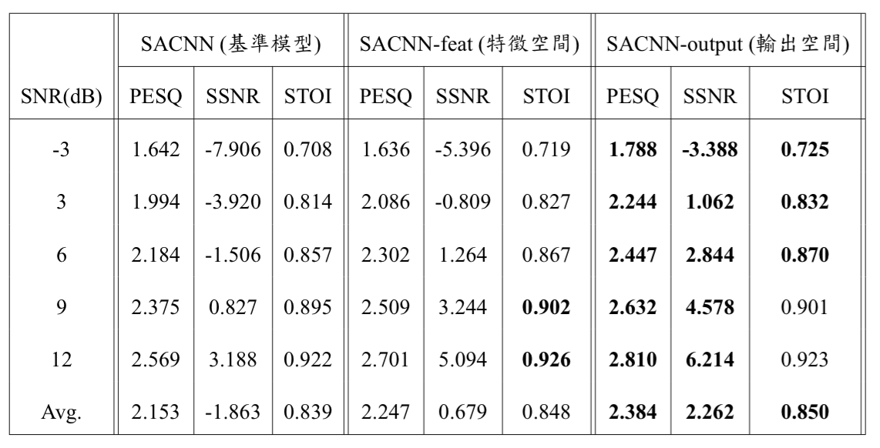
Results
Adaptation at self-attention layer output
Source data only
No notable improvement on STOI
Significant improvement

Slide 13
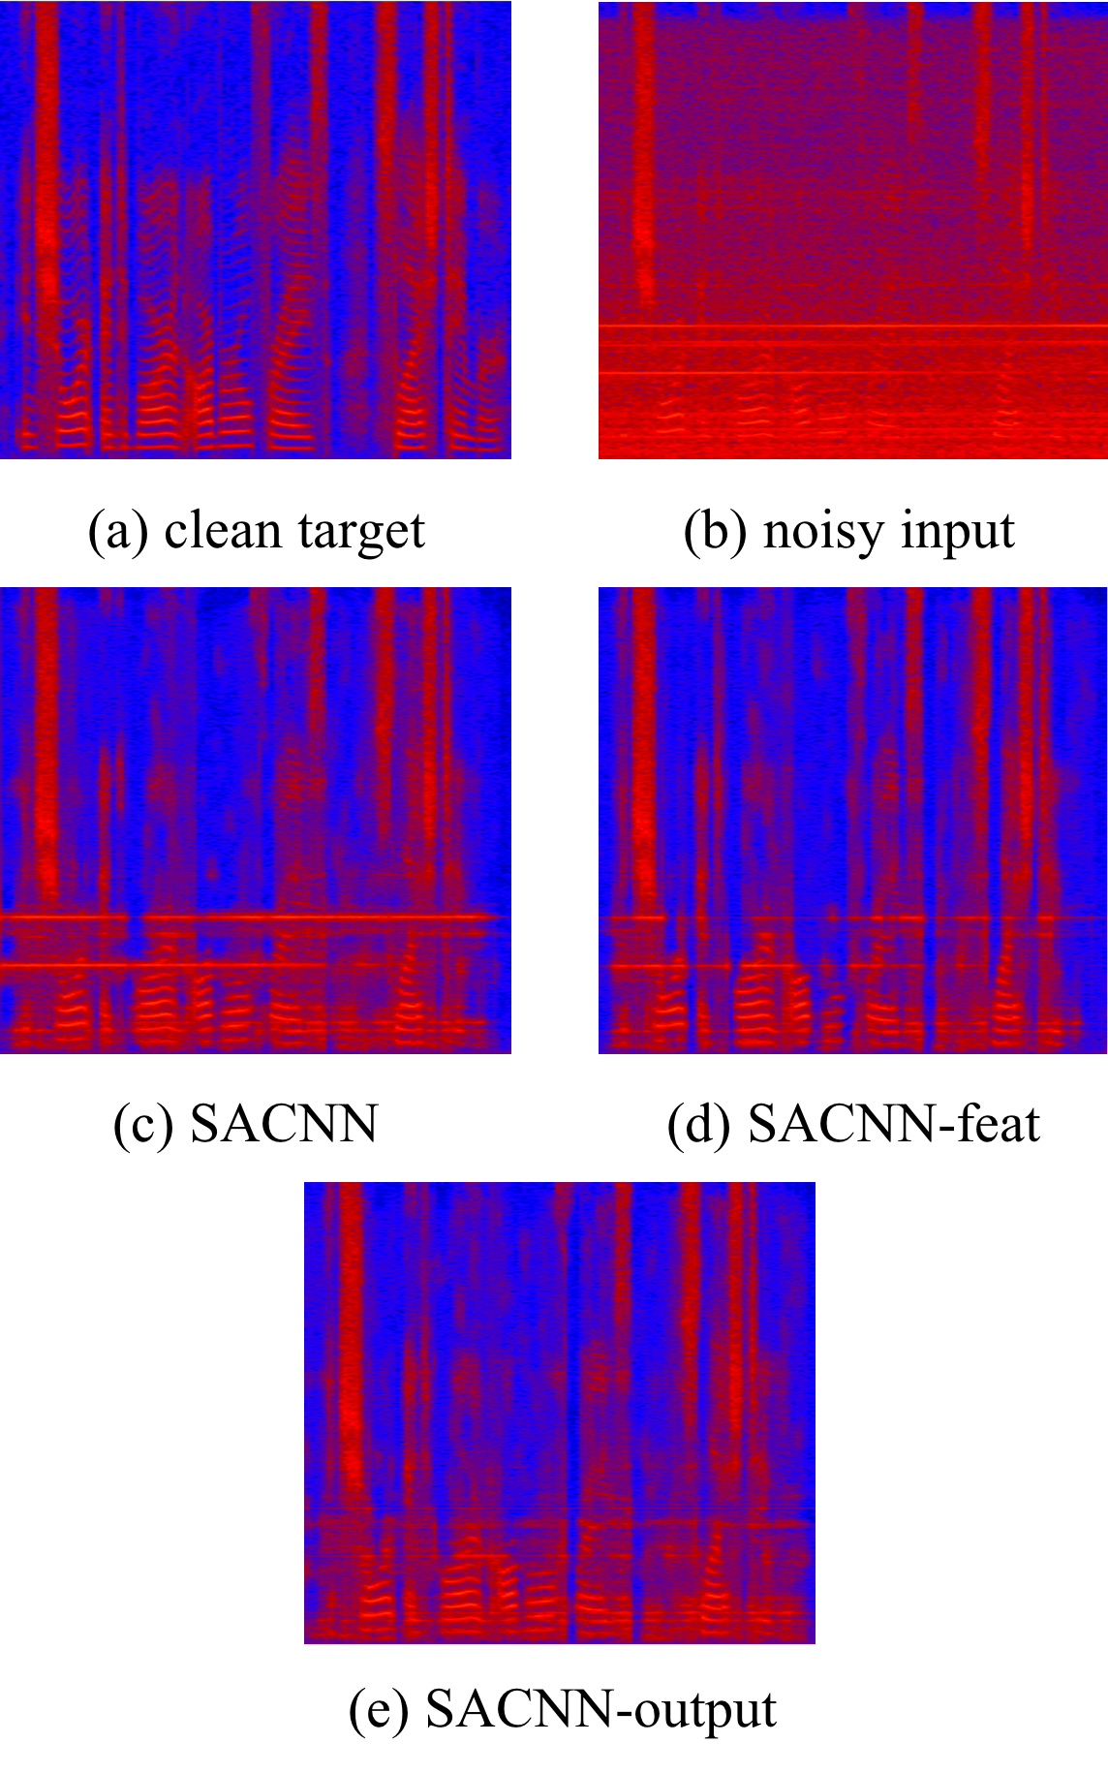
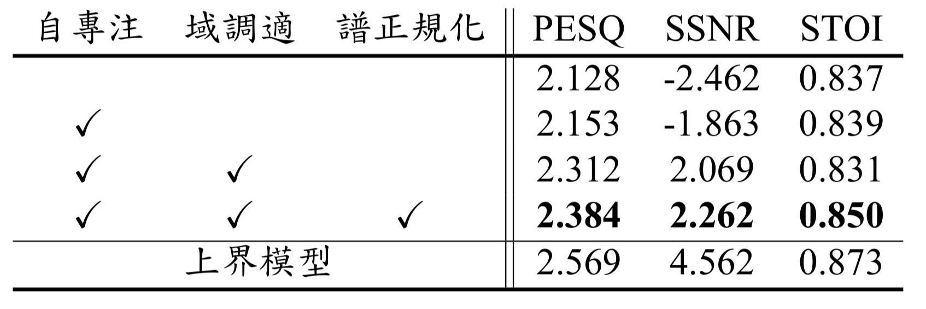
Results
Ablation study
Spectrograms
Performance burst on PESQ and SSNR when using DAT
Spectral normalization stablize the training
Notes:
分別針對self-attention、adaptation、spectral normalization做了ablation study

Slide 14
Conclusion
DAT only needs a few noisy data to achieve notable improvements w.r.t. quality and intelligibility
Noises are consistently suppressed (SSNR)
Output space DAT > feature space DAT

Slide 15
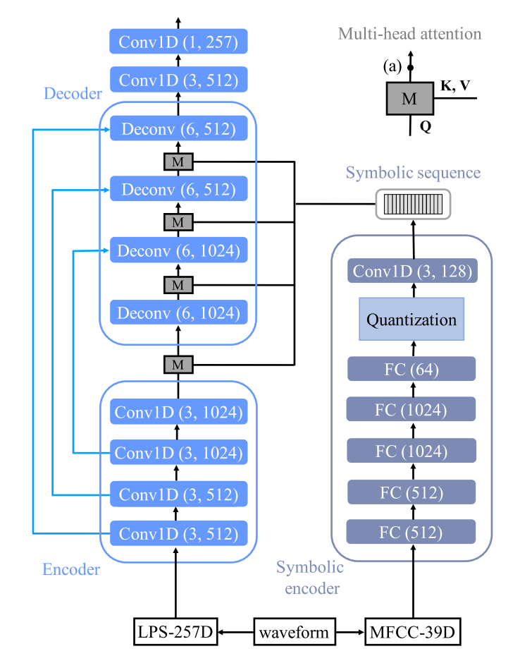
Speech enhancement
High-level information (Interspeech 2019)
Liao, C. F., Tsao, Y., Lu, X., & Kawai, H. (2019). Incorporating Symbolic Sequential Modeling for Speech Enhancement.

Slide 16
Motivation
Non-native listeners require great effort in a noisy environment
Strong internal “language model” (e.g. native listeners) = noise robustness
Notes:
The motivation is that, when in a noisy environment, non-native listeners often need to put in more effort than the native listeners.
In other words, native listeners have a stronger built-in language model, which provides some level of noise robustness.

Slide 17
Motivation
Symbolic sequence encoder
Does not need direct access of ASR results
Extracts high-level phoneme-like representation to guide SE
enhanced
symbolic
sequence
Enhancement
model
Symbolic
encoder
noisy
Notes:
So, what we‘d like to have is an encoder that can extract high-level phoneme-like representations, which are unsupervisedly learned, to guide the enhancement system, meanwhile doesnt need a direct access of ASR results or any ground truth transcriptions during training. And the VQVAE fits our goal perfectly. And we call this encoder a symbolic encoder, since it produce discrete symbolic vectors

Slide 18
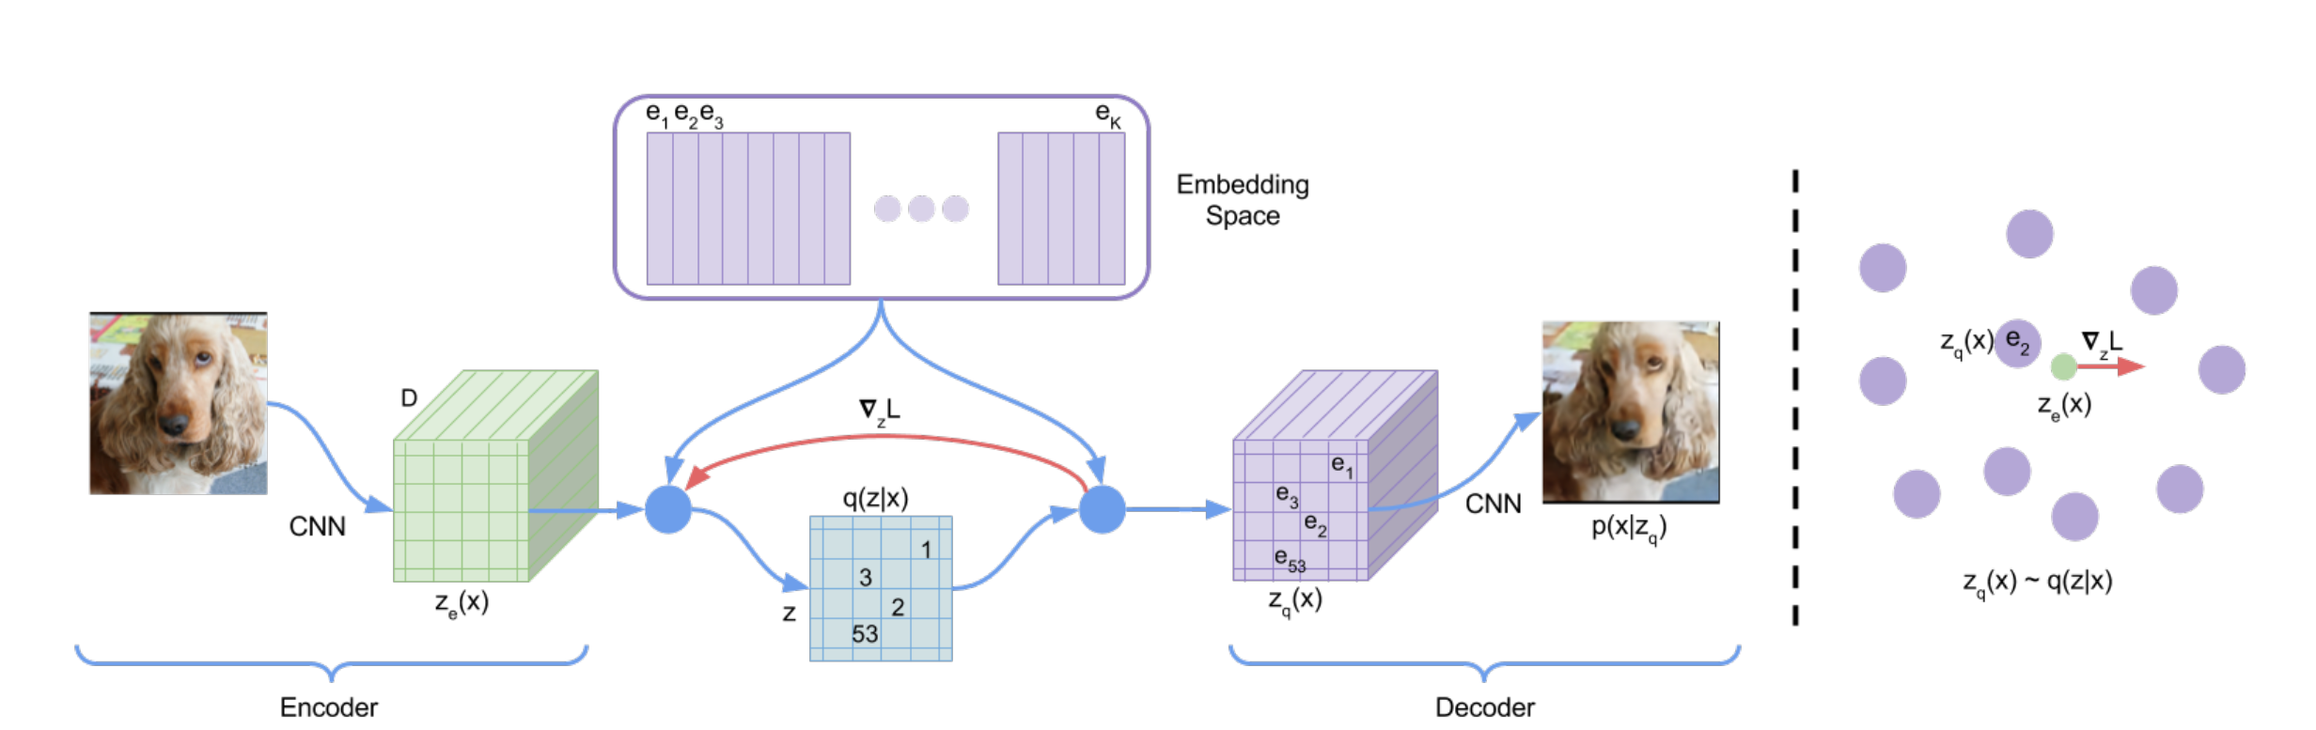
Related work
Vector Quantization VAE
“…discrete representations obtained using the VQ-VAE preserved the most phonetic information while also being the most speaker-invariant”…
Notes:
A comprehensive study of VQ-VAE applied to speech data was carried out by Chorowski, and the conclusion is that discrete representations obtained using the VQ-VAE preserved the most phonetic information while also being the most speaker-invariant.

Slide 19
SymbolicSE
Symbolic encoder
U-Net architecture
Multi-head attention
Notes:
We apply a standard multi-head attention mechanism to combine the symbolic sequence with the enhancement model. The symbolic sequence is used as keys and values, in this way, the decoder acts as some kind of TTS model, since the symbolic sequence contains high-level phoneme information. But to generate the original clean speech, we also need speaker information as well, and the skip-connections can provide the necessary information flow.

Slide 20
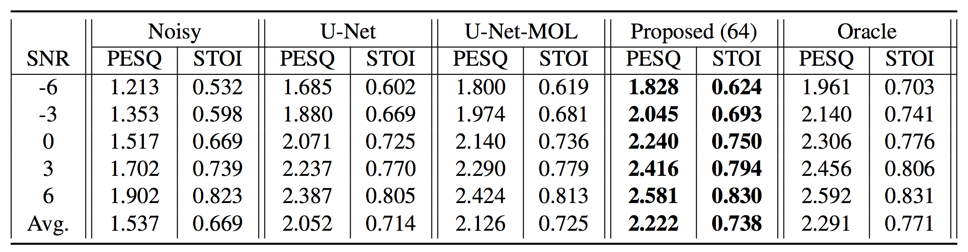
Objective evaluation
Oracle performs the best, confirms our hypothesis.
Proposed(64) > U-Net-MOL > U-Net across all SNR levels.
Notes:
Then we can see that the proposed method is better than the two baselines across all SNR levels, especially at higher SNR. Here the number 64 suggests the number of tokens in the codebook.

Slide 21
Conclusion
Incorporate phonetic content into a SE system, without the need for a recognition system or any transcriptions during training.
Visualize the symbolic encoder behavior, show that it is phoneme sensitive.
Notes:
In this paper, we proposed a

